Slide 1
UPTYCS INTERNSHIP PROJECT
Zain Muhammed and Yuvan Pradhan

Slide 2
PROBLEM STATEMENT
Design a Q&A system which takes as input a question and returns the intent and entity. If the server is REST based or GRPC based it would be good

Slide 3
TECHNICAL TERMS
Named entity recognition(ner)
A subtask of information extraction that helps us label and classify important terms in a statement.
Ex:
I want to eat pizzas and burgers.
Intent classification(ic)
The automated categorization of text data based on user’s goals
Ex:
I want to eat pizzas and burgers.

Slide 4
Models
Joint model for NER and IC using BERT
Custom NER using SPACY
NER and IC using RASA NLU

Slide 5
Joint model using bert
This method was not viable due to a lack of data.
Research paper used as reference:
https://ieeexplore.ieee.org/stamp/stamp.jsp?arnumber=9599152

Slide 6
Custom ner model using spacy
Advantages
Easy to use
Provides accurate results
Disadvantages
Could not do both NER and IC with the same model
Annotating training data was tedious as it had to be done manually

Slide 7
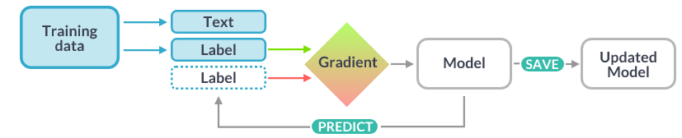
SpaCy Flowchart

Slide 8
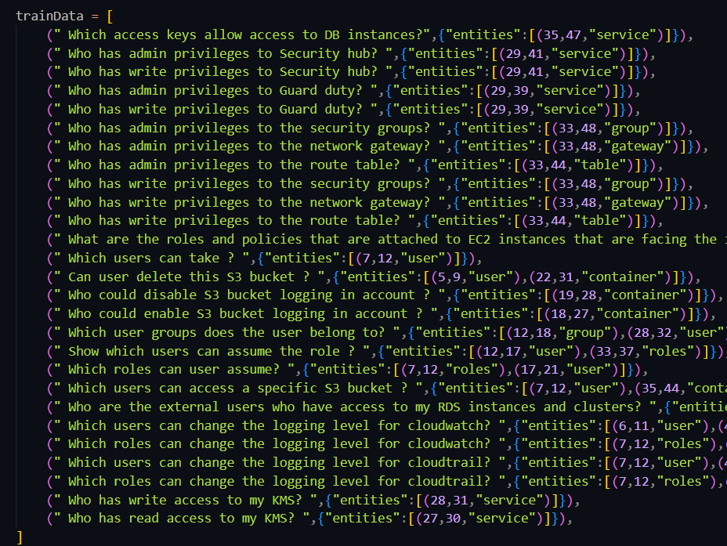
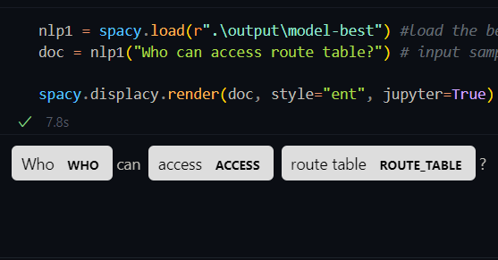
Annotation of training data
Output

Slide 9
Joint model using rasa nlu
Advantages
Easy to configure
Can do both NER and IC with the same model
Works well with a small dataset
Open-source
Disadvantages
Lower accuracy
Has a high learning curve

Slide 10
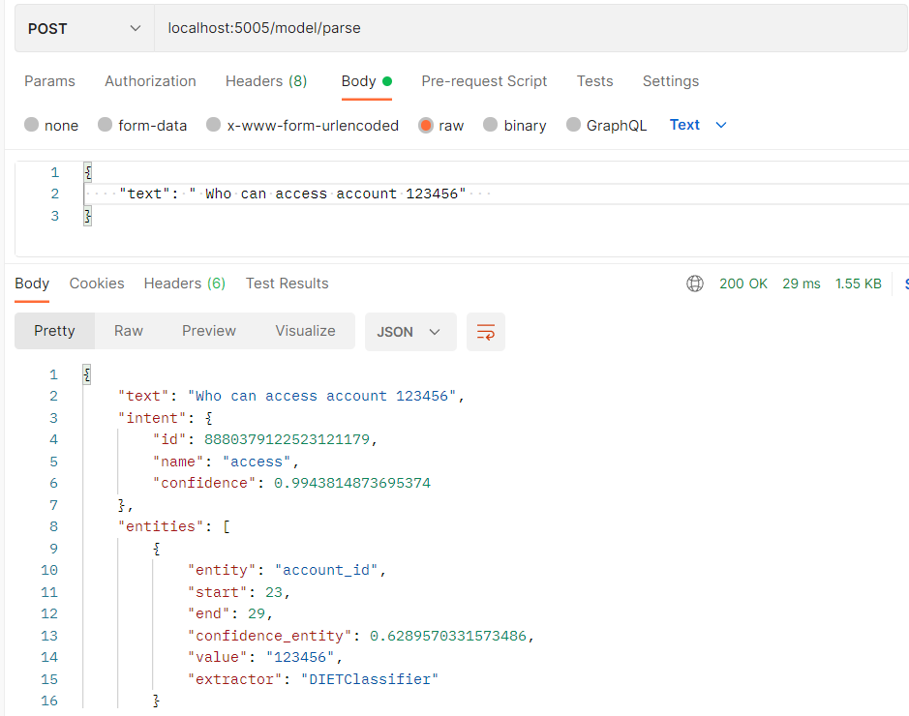
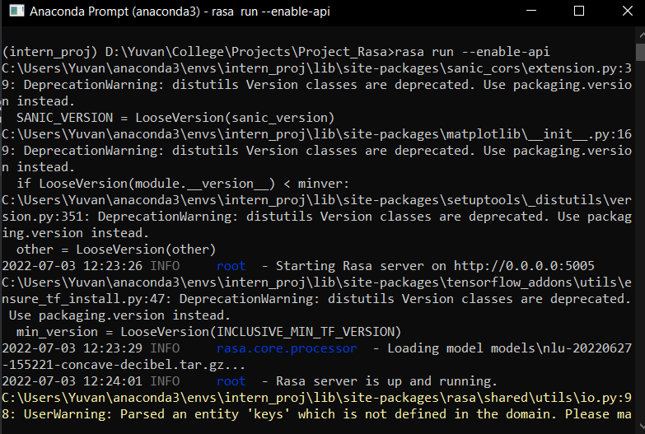
RASA server
Output

Slide 11
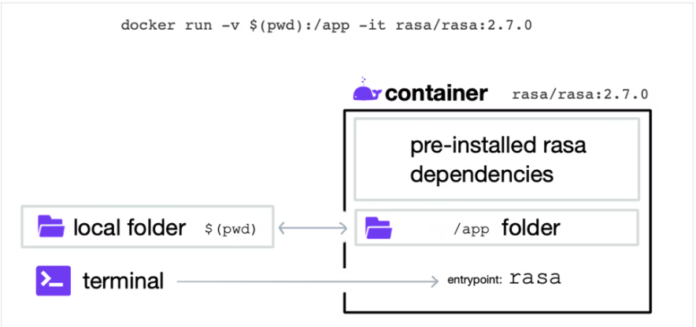
Docker flowchart

Slide 12
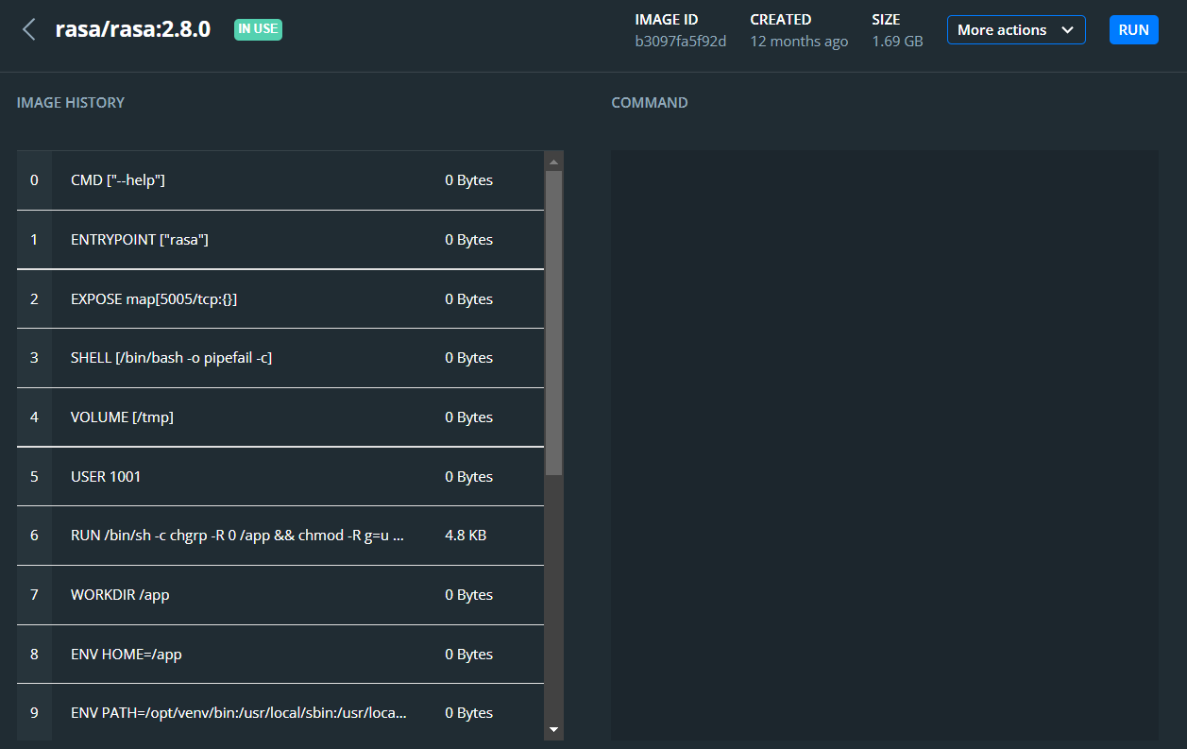
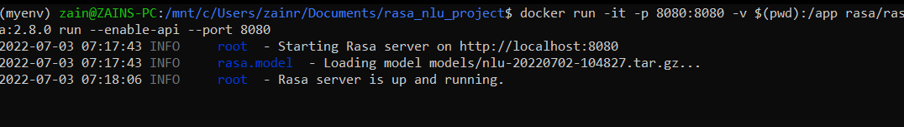
Running on Docker

Slide 13
THANK YOU
Zain Muhammed
Yuvan Pradhan

